Slide 1

How can we support DTS as a FAIR API for publishing digital text collections?
Matteo Romanello
Conference Open Up Digital Scholarly Editions
University of Zurich – 26 January 2024

Slide 2
What’s DTS?
DTS = Distributed Text Services
DTS provides a standard way for clients to interact with collections of TEI documents. A standard API allows users to access many text collections using the same client software. It also allows editors to publish text collections in a usable way that existing clients can use.
DTS strives for genericity:
No requirements on collection structure
No requirements on how the texts are structured
No requirements on identifiers
Metadata as you wish

Slide 3
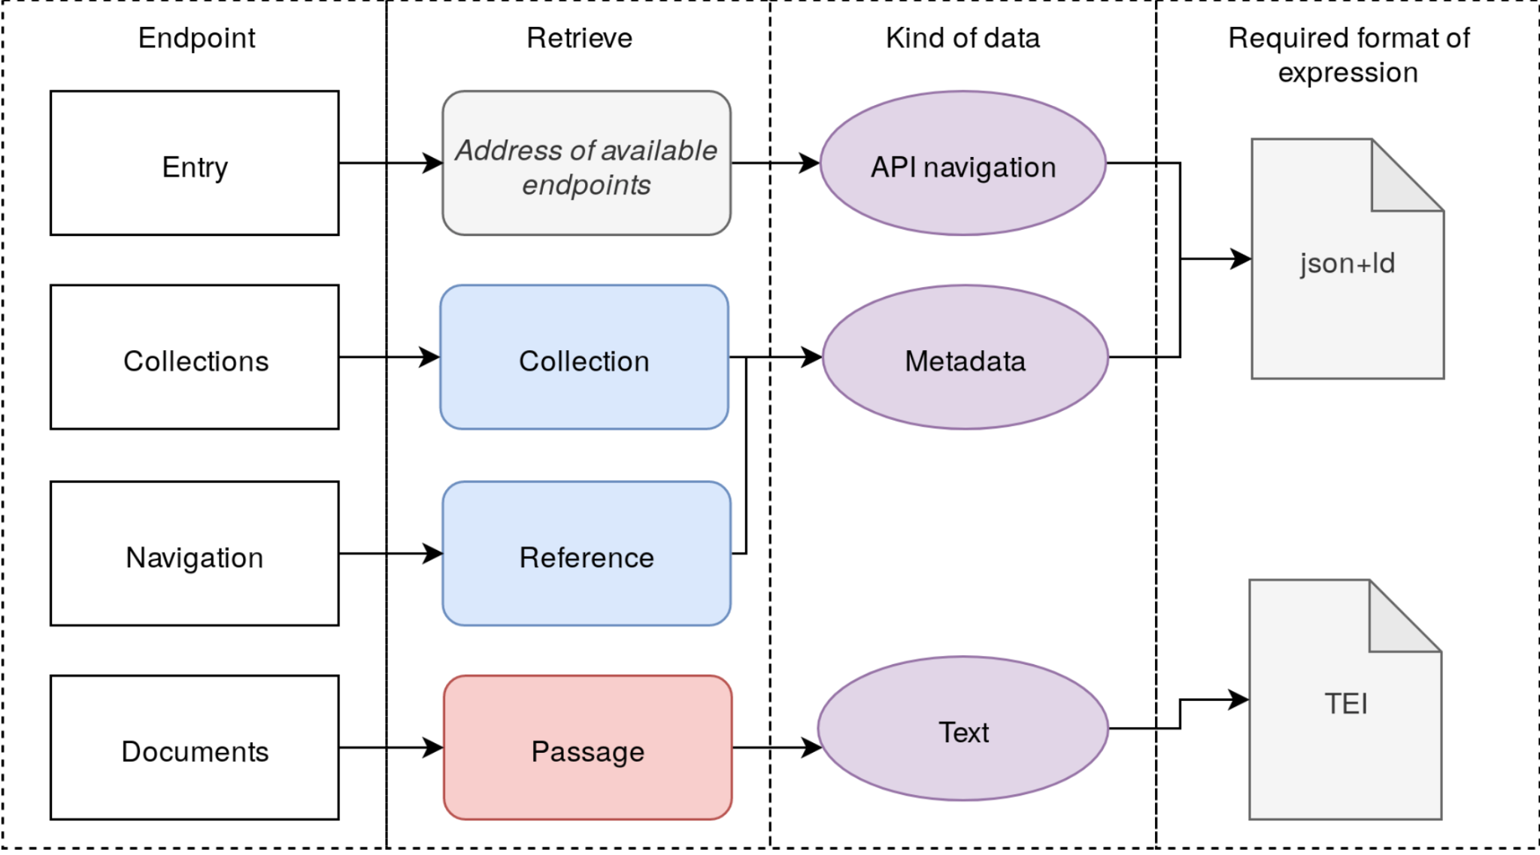
DTS at a glance
DTS allows to:
Navigate inside text collections
Fetch metadata for a collection/text
Discovery the citation structure of a document + navigate it
Access a representation of the text itself
Documentation: https://w3id.org/dts
jTEI paper: https://doi.org/10.4000/jtei.4352

Slide 4
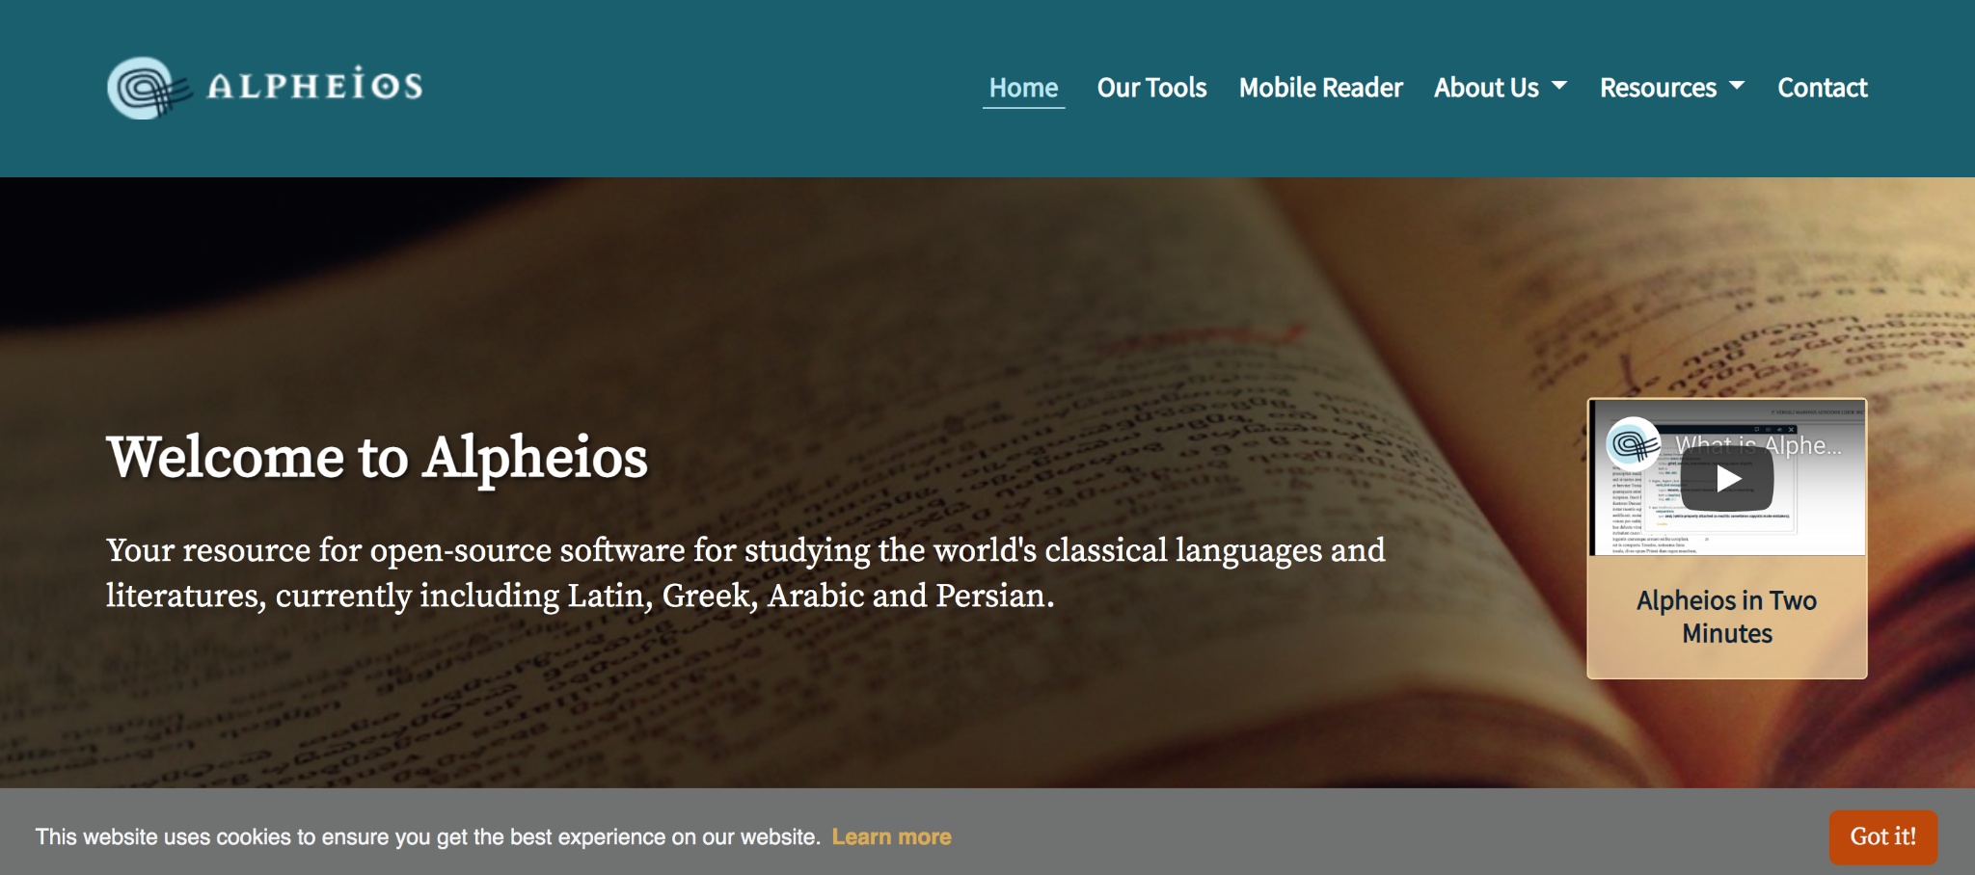
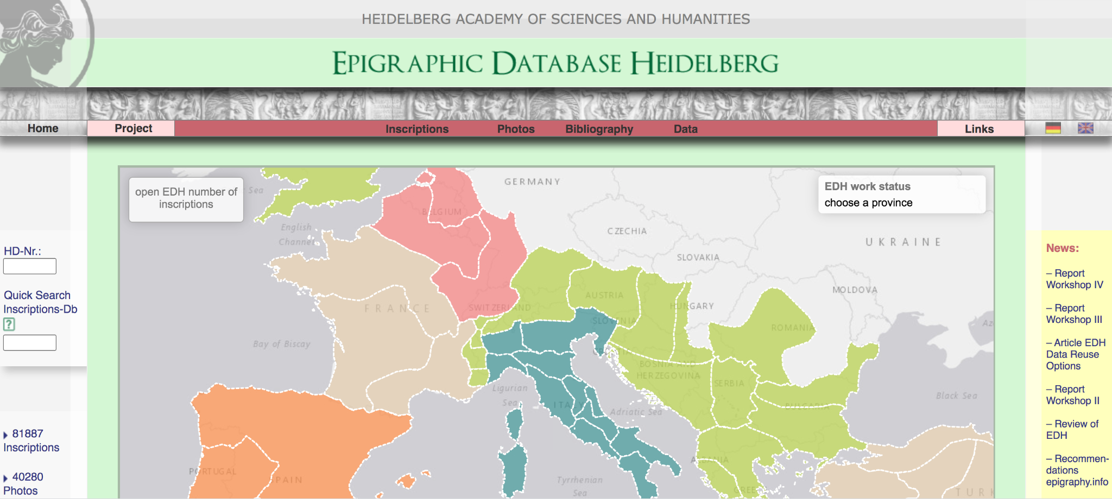
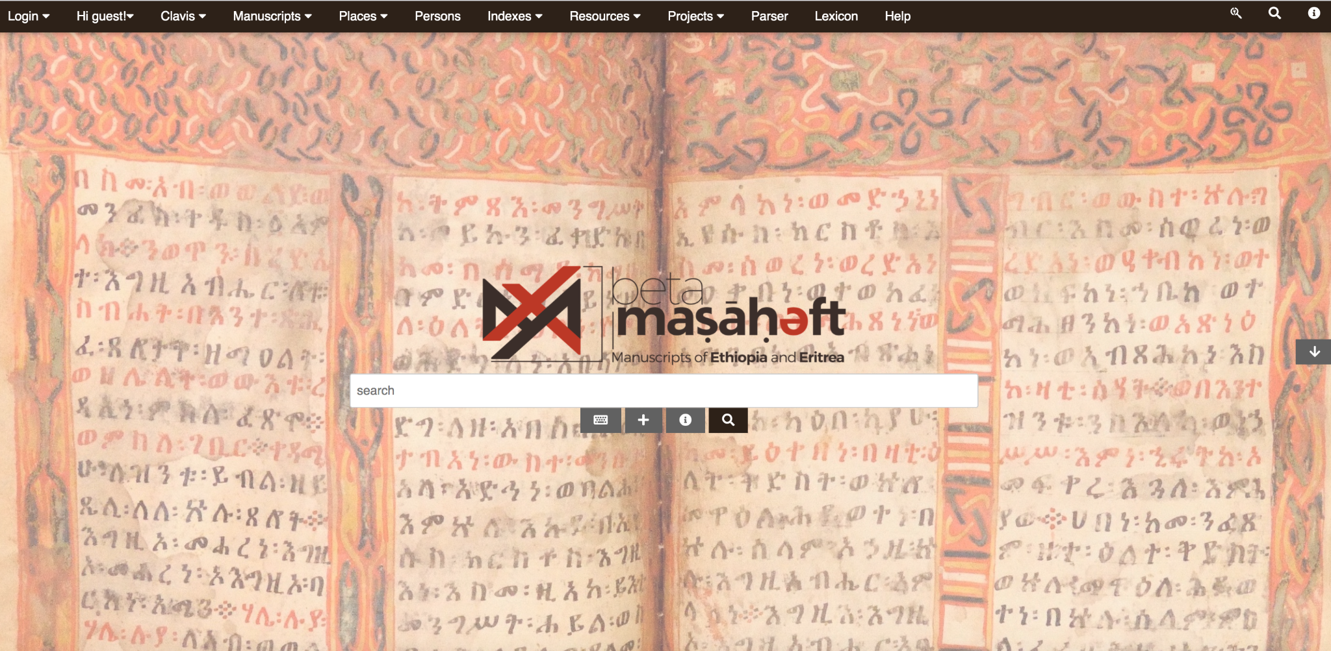

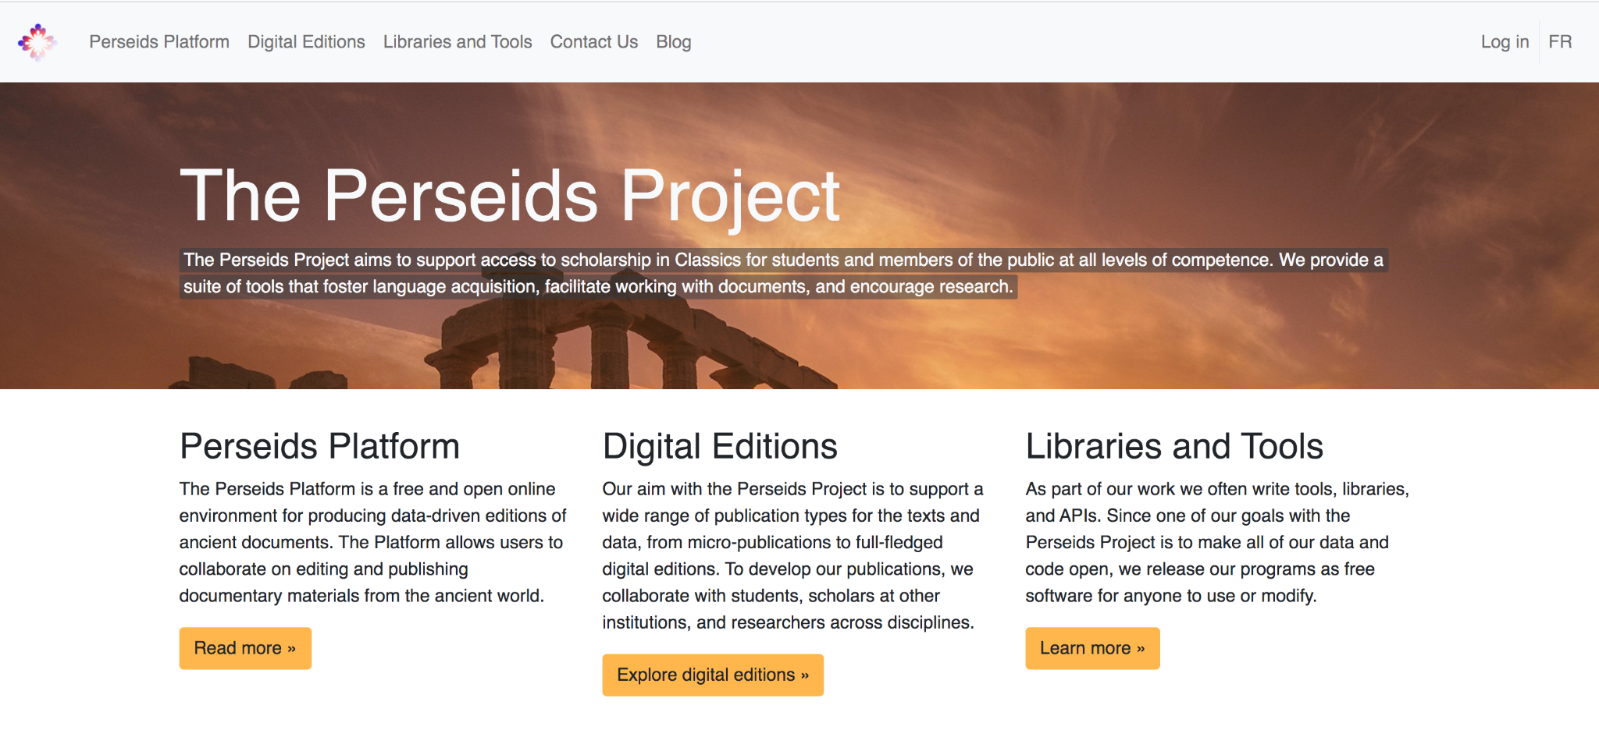
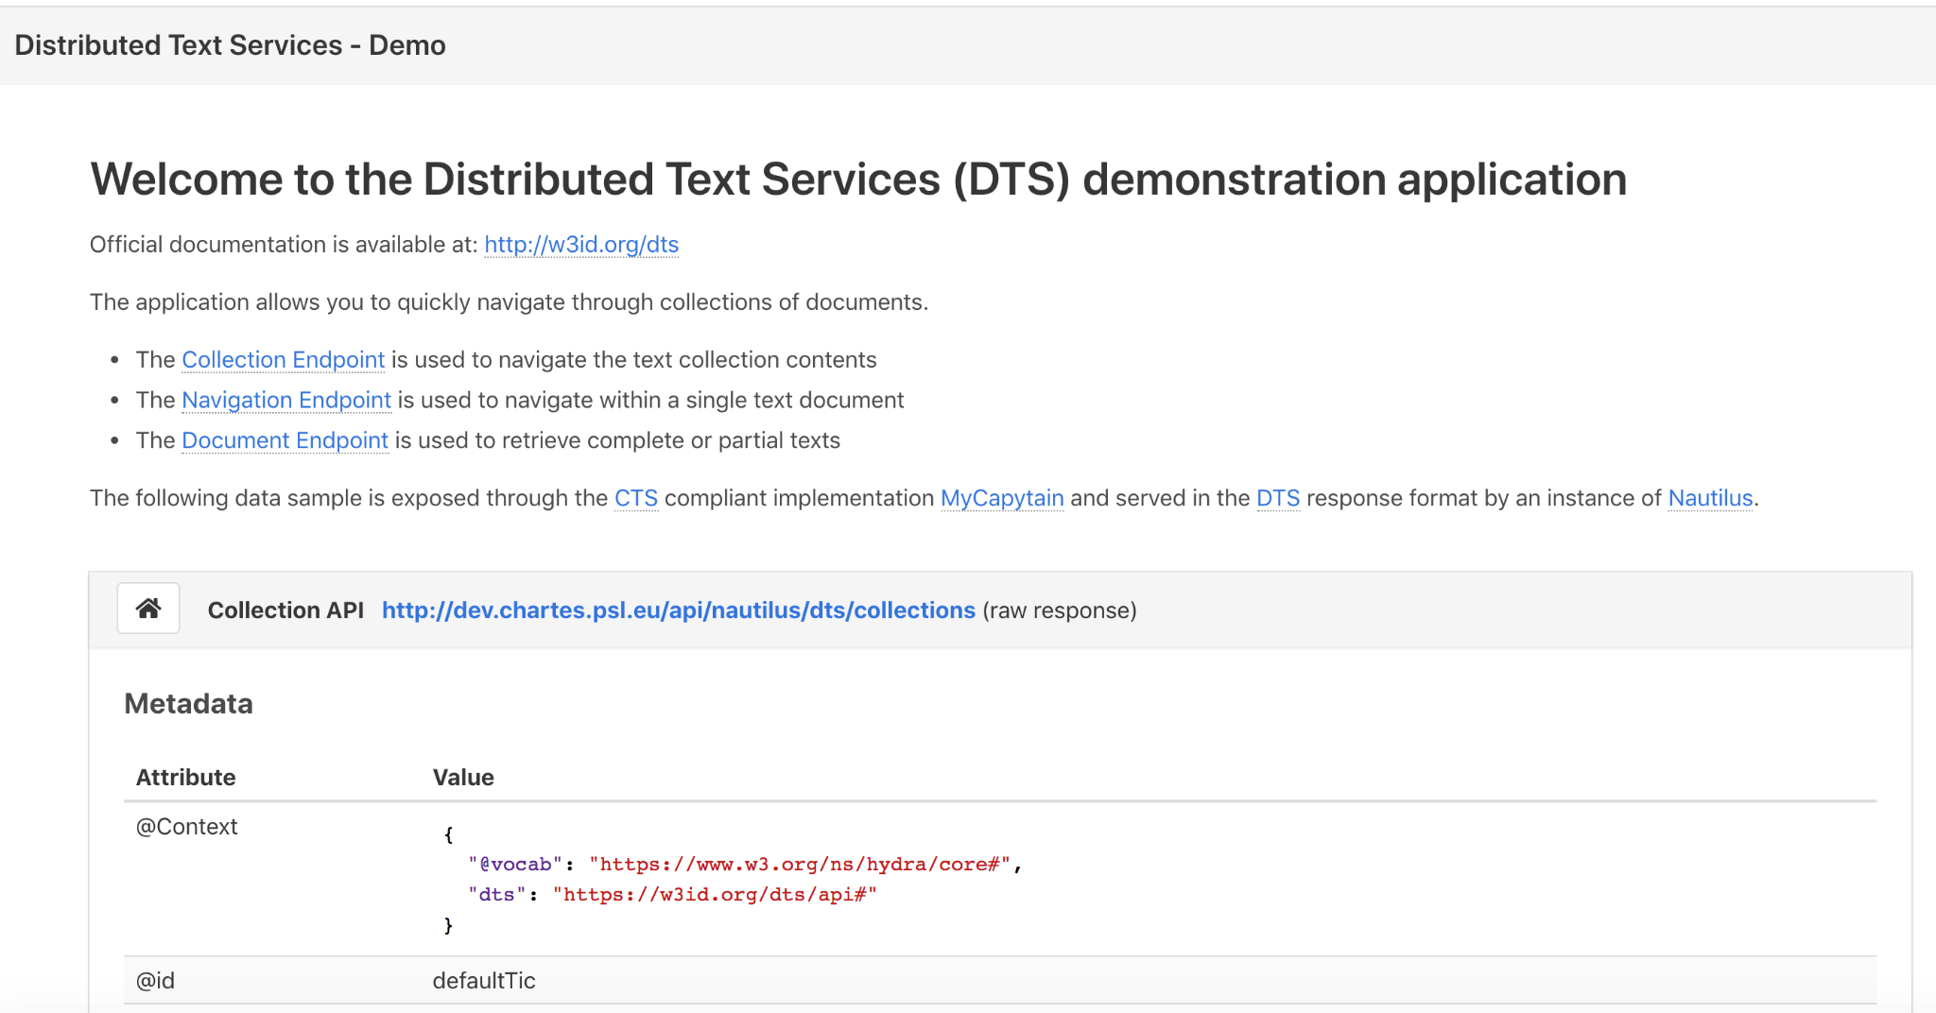
Corpora with a DTS API
http://alpheios.net/
https://edh-www.adw.uni-heidelberg.de/
http://betamasaheft.eu/
https://www.perseids.org/
https://dev.chartes.psl.eu/dts-demo/
TEI Publisher instances*

Slide 5
How’s DTS FAIR?
Findable
F1. (Meta)data are assigned a globally unique and persistent identifier
Collections and documents have their unique identifiers
Granularity of access: down to the passage level
Definition of identifiers as broad as possible (essentially any URI)
Retrocompatible with e.g., CTS URNs
Wikidata URIs can be used as identifiers for DTS collections/documents

Slide 6

How’s DTS FAIR?
Findable
F4. (Meta)data are registered or indexed in a searchable resource

Slide 7
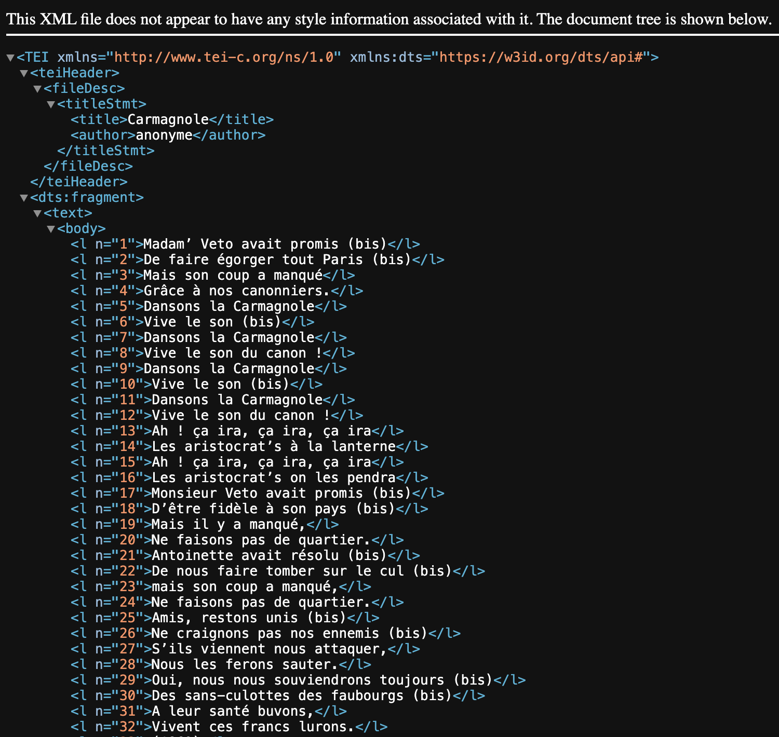
How’s DTS FAIR?
Accessible
Access to texts via the documents endpoint
Serialization format for textual data is TEI/XML
No support for authentication
http://tnah.chartes.psl.eu/2019/dts/document?id=https://wikidata.org/wiki/Q1043500

Slide 8
How’s DTS FAIR?
Interoperable
Reusable
Interoperability
API → Hydra API specification
Metadata → JSON-LD
Data → TEI/XML
Reusable
Dublin Core terms for metadata descriptions
Other vocabularies can be used inside the dts:extensions property

Slide 9
How to grow DTS’ support and adoption?
The last 5 years:
1st DTS workshop (2019)
First public draft (2020)
Online DTS Hackathon (2021)
jTEI paper (2023)
First public version (spring 2024)
Resources are needed for:
update/maintain specifications
develop/update reference implementations
Run dissemination activities
Future of DTS?
How to unlock adoption by institutions (universities, libraries, publishers)?
Is a DTS Consortium the way to go?
Can existing national/international associations help?

